Slide 1
Fake Job Posting Detection
Real-world NLP + ML-based Fraud Detection
Pallavi Billava · Viranchi More · Mahalakshmi Kumar
May 6, 2025

Slide 2

Motivation & Problem
Online job scams are increasing, putting job seekers at risk.
Fake postings lead to phishing, fraud, and data theft.
These listings often look legitimate and escape manual review.
Manual detection is time-consuming and not scalable.
Our goal: build an ML model that flags fake job ads based on text and metadata.

Slide 3
Dataset Overview
Dataset: Fake Job Postings (Kaggle), ~17,880 records, 18 fields.
Target: fraudulent (1 = Fake, 0 = Real).
Key Fields:
title, description, requirements: core job content (text).
salary_range: parsed to compute average salary.
location: used to flag remote jobs.
company_profile, benefits: additional context.
Missing Data:
Dropped entries with missing title or description.
Filled other nulls (e.g., benefits, company_profile) with empty strings.

Slide 4
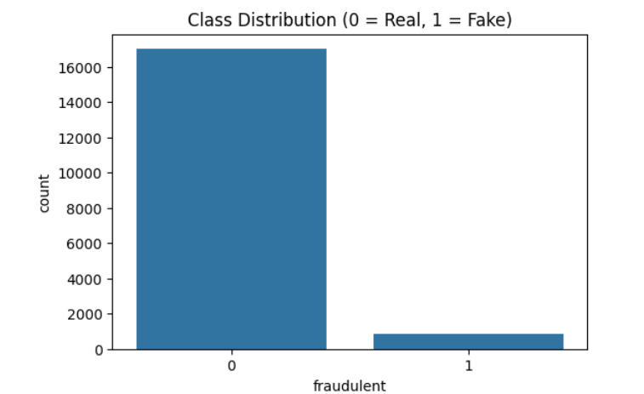
EDA & Feature Engineering
Class Imbalance: ~95% real, ~5% fake → handled using SMOTE.

Slide 5

Word Cloud Top keywords in job descriptions.

Slide 6
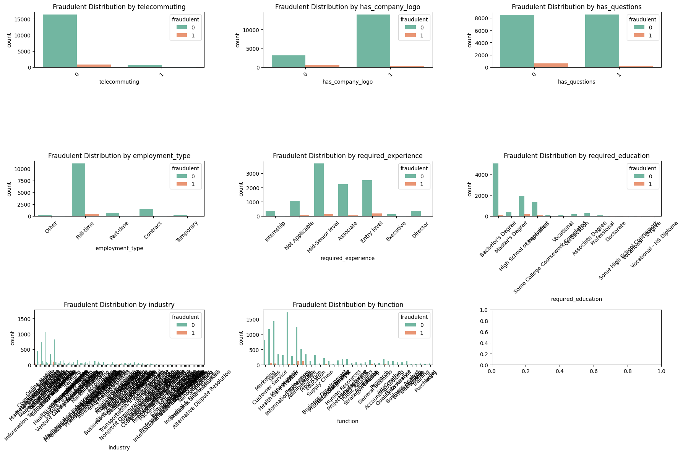
Fraud Distribution by Categorical Features These plots help us explore how fake job posts vary across different job attributes.

Slide 7
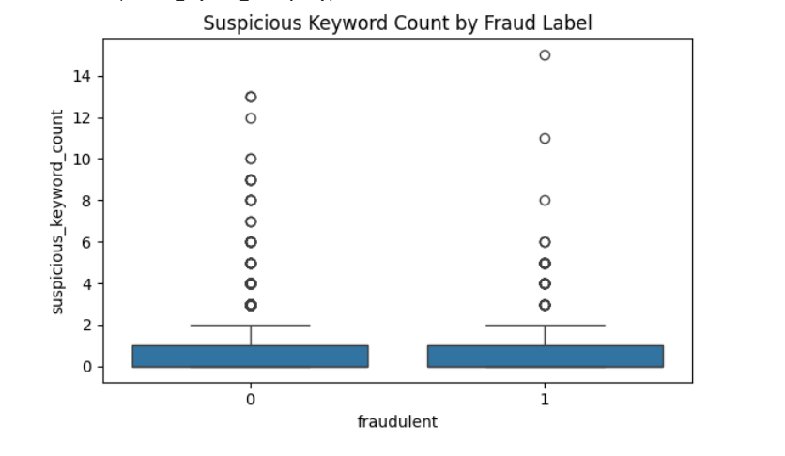
Boxplot compared suspicious word count for fake vs real.
The median suspicious keyword count is similar for both real and fake jobs — often near 0.
However, fake jobs (label = 1) have more outliers with high suspicious word counts.
Some fake jobs contain over 10–15 suspicious keywords, while real jobs rarely exceed 4–5.

Slide 8
Preprocessing Steps
Goal: Clean and enrich the dataset for effective model training.
Key Steps:
Text Merging: Combined title, description, requirements, etc., into combined_text for unified analysis.
Handeled Missing Data.
Feature Engineering:
suspicious_keyword_count: Count of scam-related phrases (e.g., “money transfer”, “urgent hire”).
is_remote_flag: 1 if "remote" detected in location/title, else 0.
avg_salary: Average computed from salary range if available.
missing_salary_flag: Indicates missing salary data.
years_experience: Extracted using regex patterns from text.
Text Vectorization:
Applied TF-IDF with bigrams on combined_text.
Limited to top 7000 features to reduce dimensionality and noise.

Slide 9
Model Implemented
Train-Test Split:
80-20 split using stratified sampling to retain class imbalance pattern.
Balancing the Dataset:
Applied SMOTE to oversample fake class during training.
Avoided data leakage by only resampling X_train.
Models Compared:
Logistic Regression: Baseline linear model.
Random Forest: Ensemble of decision trees.
XGBoost: Gradient Boosted Trees with handling for class imbalance.

Slide 10
Model Evaluation
Metrics Used:
Accuracy: Overall correctness (less relevant for imbalanced data).
Precision: % of predicted fake jobs that were actually fake.
Recall: % of actual fake jobs the model identified.
F1-Score: Balance between Precision and Recall.
AUC-ROC: Classifier’s ability to separate real vs fake jobs.
Model | Accuracy (%) | ROC-AUC Score | Notes
XGBoost | 98.85 | 0.989 | Best overall performance across all metrics
Random Forest | 98.57 | 0.991 | Strong accuracy but slightly lower recall for fake jobs
Logistic Regression | 73.24 | 0.617 | Poor at detecting fake jobs (low precision/recall)

Slide 11
Model Evaluation
Best Model (XGBoost) Performance:
Precision (Fake Class): ~85%
Recall (Fake Class): ~91%
F1-Score (Fake Class): ~88%
AUC Score: > 0.95
Key Takeaway:
High Recall ensures most fake jobs are caught.
Strong AUC confirms model’s robustness even under class imbalance.

Slide 12
Why XGBoost Won:
Tuned scale_pos_weight to focus more on detecting the rare fake job class
Regularization reduced overfitting on noisy data.
Highest Recall and AUC on fake class (most important for detection task)

Slide 13
Streamlit Interface
Built web app using Streamlit.
User inputs job details via form.
Model returns label and confidence score.
Demo shows clear results for both real/fake jobs.

Slide 14
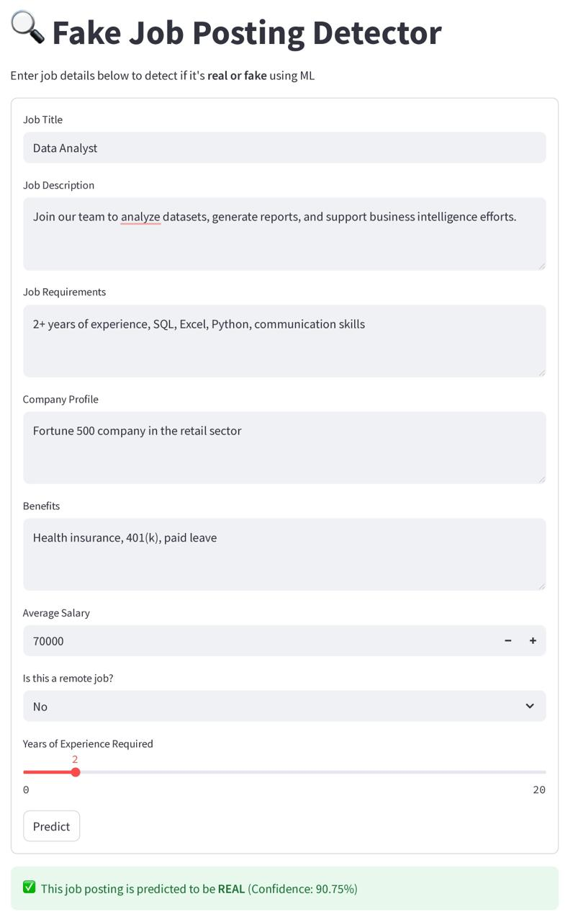
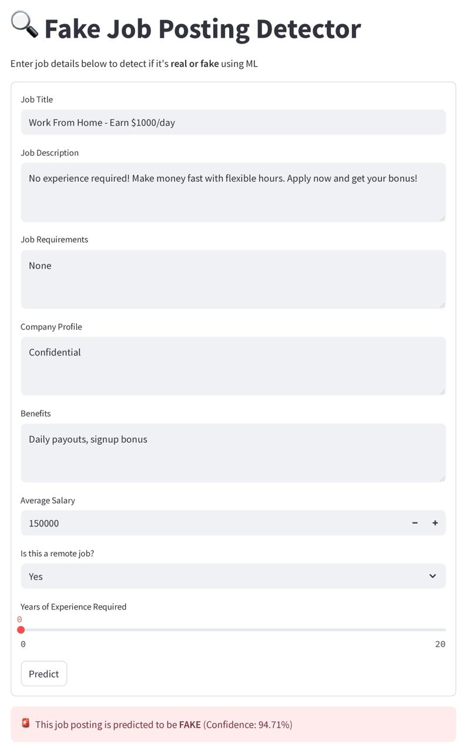

Slide 15
Conclusion & Future Work
We developed a robust ML pipeline combining:
TF-IDF with bigrams for text vectorization (NLP).
Engineered features like salary, remote flag, keyword counts.
SMOTE + Stratified Splitting to address class imbalance properly.
Model comparison across Logistic Regression, Random Forest, and XGBoost.
Next steps:
Use transformer-based models (e.g., BERT) for better semantic understanding.
Integrate SHAP/LIME for model explainability.
Deploy on live job board feeds for real-time fraud detection.

Slide 16

Question? Thank You

